Slide 1
RECONFIGURABLE PROCESSOR ARCHITECTURES

Slide 2
Contents
Introduction
History
Reconfigurable Processor Architecture
Advantages and limitations
Applications
Conclusion

Slide 3
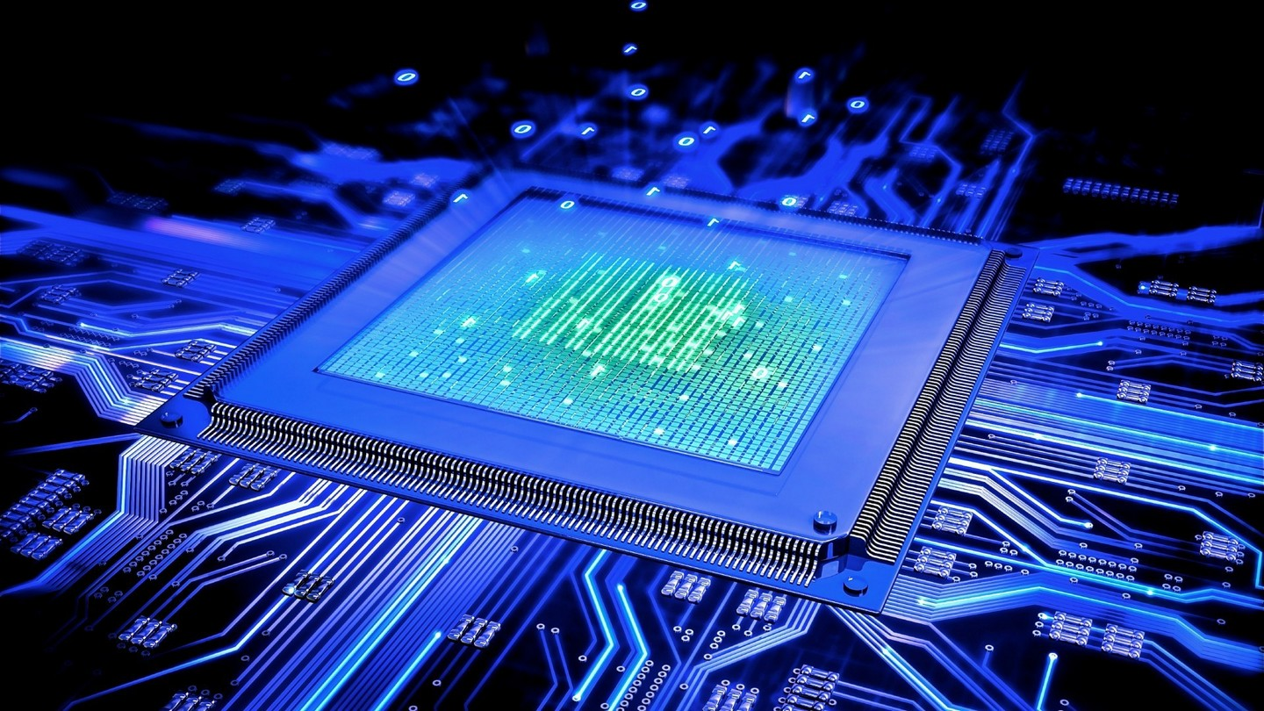
INTRODUCTION

Slide 4
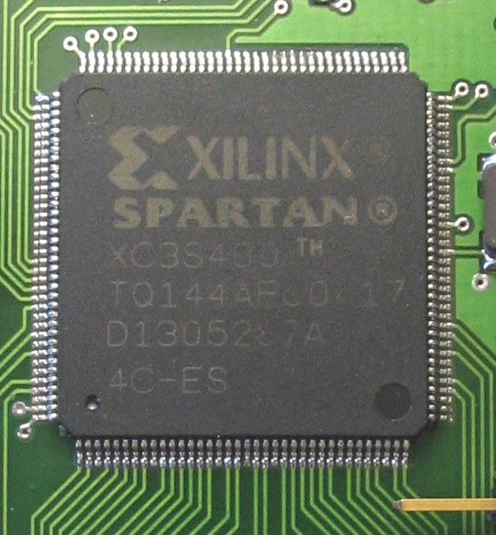
The title says it all..!!!
Reconfigurable – Something that can be reconfigured or altered
Processor – An electronic (logic) circuitry that carries out the basic functions like basic arithmetic, logical, control or input/output that in turn drives a system
Architecture – The general term to describe a physical structure

Slide 5
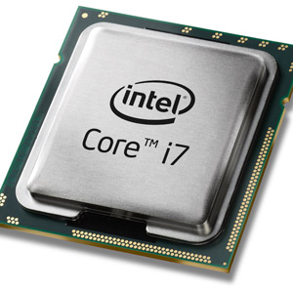
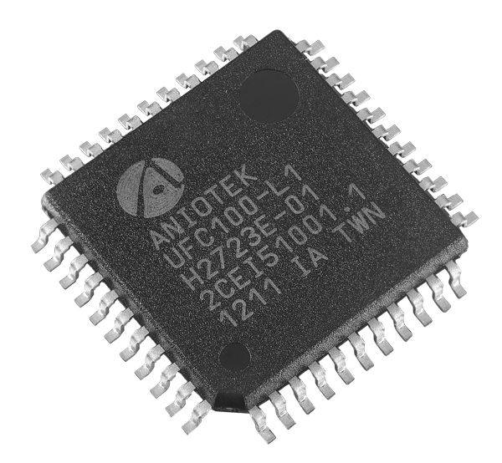
Processing Circuits
Processing circuits can be broadly classified into two:
General Purpose Processors (GPP)
Application Specific Processors / Circuits (ASIC)

Slide 6
A comparison between GPP and ASIC
General Purpose Processors Executes a set of instructions Performance can suffer because of fetch, decode and execute cycles Different sets of instructions can be executed and hence is highly flexible Low cost and time of development | ASIC Executes the function, the circuit is designed for Very fast and efficient execution as they are pre-tailored Can only do the function the circuit is designed for High cost and time of development

Slide 7
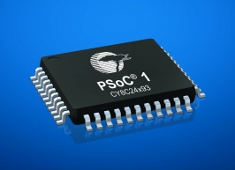
Reconfigurable Processors
These come in between ASICs and GPPs
They combine the flexibility of GPP and the performance of ASIC
E.g. of RPs: FPGA, Chameleon Processor, PSoC

Slide 8
What are Reconfigurable Processors ?
Reconfigurable processors (RP) combine the speed of application specific integrated circuits (ASIC) and the universality of general purpose processors (GPP) by means of adaptability to the currently executed code
That is, they can configure it’s internal circuitry according to the function that is being performed by the processor

Slide 9
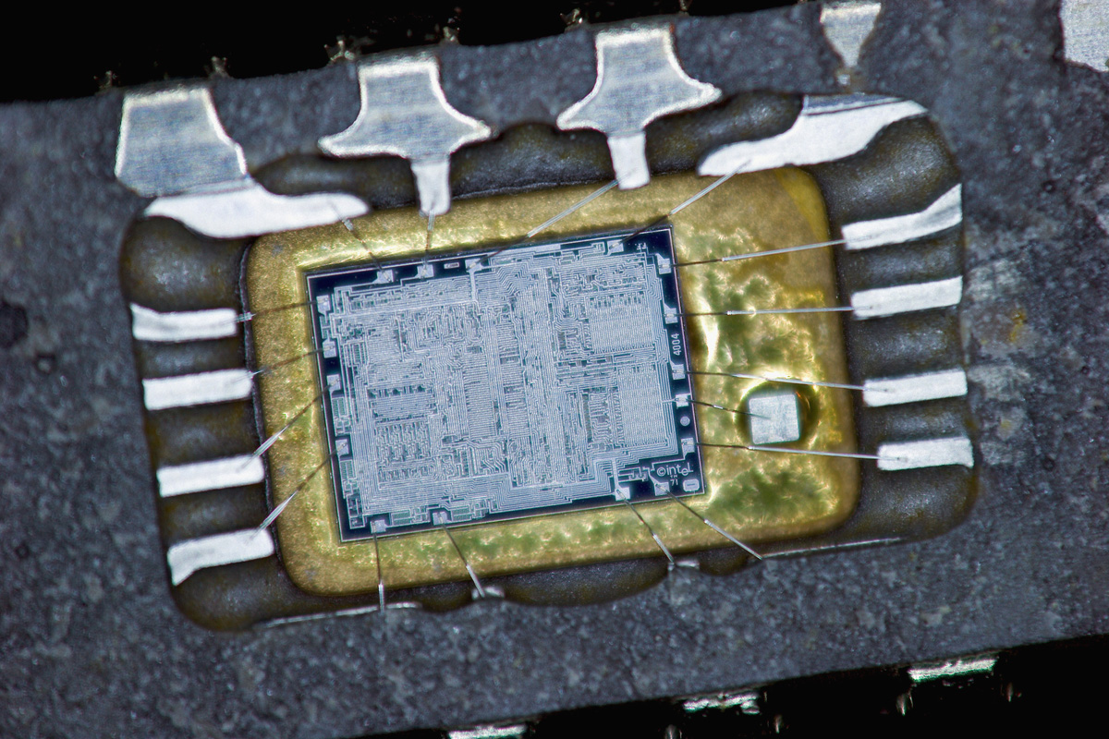
HISTORY

Slide 10
A peek into history
First programmable devices
Advent of reconfigurable hardware
Reconfigurable processors

Slide 11
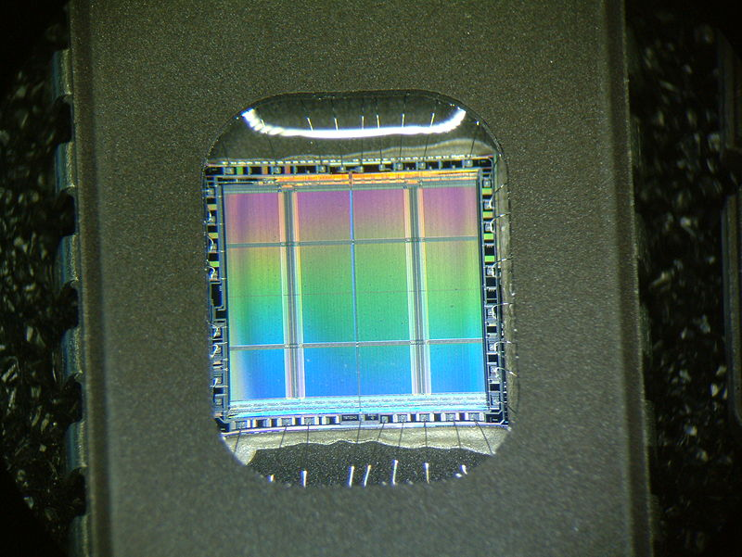
First programmable hardware
First programmable devices where ROMs (Read Only Memory)
They were used to create arbitrary combinational logic functions of a number of inputs

Slide 12
Disadvantages of ROMs
Slower than dedicated circuits
More expensive than programmable logic, especially if high speed is required
Since most ROMs do not have input or output registers, they cannot used for stand-alone for sequential logic

Slide 13
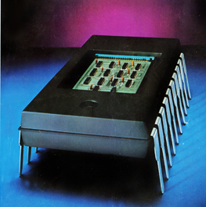
Advent of Reconfigurable Hardware
In 1969 the first reconfigurable hardware was introduced by Motorola - XC 157, a mask-programmed gate array, with 12 gates
In 1970, Texas Instruments introduced a mask programmable IC - TMS2000 (the first PLA)

Slide 14
Advent of Reconfigurable Hardware(contd …)
General Electric Company in 1971 developed the first erasable PLD based on programmable ROM technology
In 1975, Signetics introduced their Field Programmable Logic Array, the 82S100
Monolithic Memories in 1978 introduced the first PAL

Slide 15
Reconfigurable Processors
Concept stated in 1960s in a paper by Gerald Estrin
Concept consisted of a main processor controlling a reconfigurable hardware
The reconfigurable hardware was tailored to perform a specific task such as image processing

Slide 16
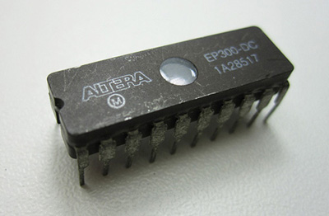
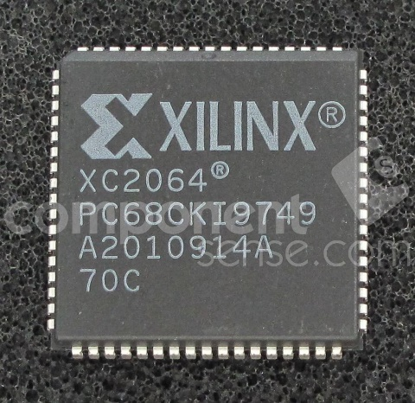
Reconfigurable Processors (contd …)
Altera in 1984 delivered the industry’s first reprogrammable logic device – the EP300
Xilinx invented the first commercially viable FPGA in 1985 – the XC2064

Slide 17
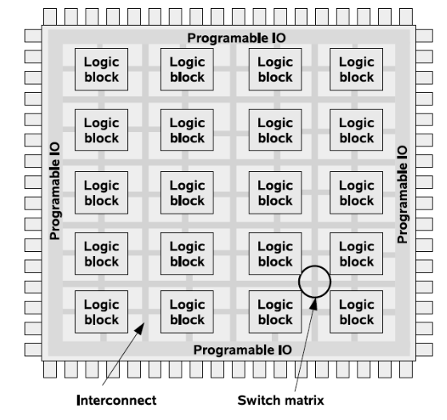
Reconfigurable Processor Architecture

Slide 18
RP architectural components
Implementation Spectrum
System Level Architecture
Granularity
Programmable Logic Elements
Reconfiguration Models

Slide 19
1. Implementation Spectrum
RPs can be implemented using PLDs, CPLDs and FPGAs
PLDs are only used in applications which require a very small number of gates
CPLDs are preferred where the logic circuits are to be small (<500 FFs), non-volatile and fast start-up operation
Modern day applications are usually done using FPGAs, since they support circuits of much more complexity (up to 150k FFs)

Slide 20
2. System Level Architecture
The system level architecture shows how the sequential processor and the RF is coupled. There are 5 different forms:
1. External standalone processing unit
2. Attached processing unit 4. Reconfigurable Functional Unit
3. Co-processor 5. Processor embedded in RF

Slide 21
3. Granularity
The maximum word length of the implemented functions
RFs can be categorised into two groups:
Fine grained
Coarse grained

Slide 22
3.1 Fine grained architectures
A fine-grained functional unit can typically implement a single function on a single (or small number) of bits
The most common kind of fine-grained functional units are the small lookup tables that are used to implement logic in FPGAs
Fine grained architectures are used in fast simple control applications

Slide 23
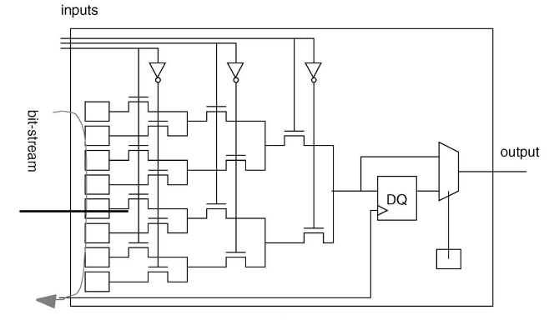
3.1 Fine grained architecture (contd …)
A look up table (LUT) is shown in the adjacent figure
Here we can see that there are basically 3 inputs at the top side and the output derived from these 3 inputs

Slide 24
3.2 Coarse grained architecture
A coarse-grained functional unit, is more larger and complicated and may consist of ALUs, MACs and possibly even a significant amount of storage.
An example is a DSP block
Coarse grained architectures are used for high bandwidth data processing like data encryption, video processing etc.

Slide 25
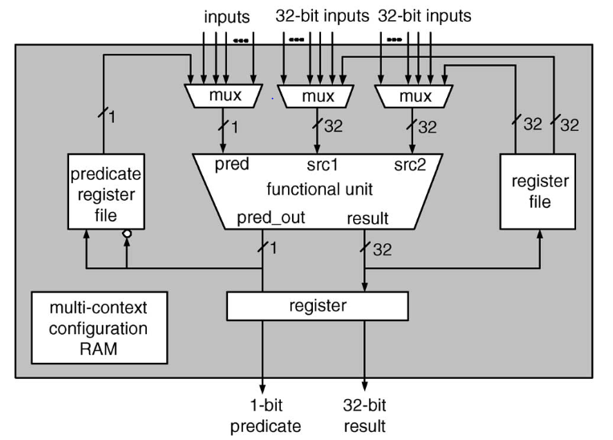
3.2 Coarse grained architecture (contd …)
The adjacent figure shows a reconfigurable unit of the ADRES architecture
Each reconfigurable functional unit in this device contains a 32-bit ALU which can be configured to implement one of several functions including addition, multiplication and logic functions and also two small register files.

Slide 26
4. Programmable Logic Elements
Programmable logic cells used to implement Boolean equations with more inputs
The complication of each logic cell is depended on the number of functions, which could be implemented on it
The RPs can be split into two categories
Those using LUTs as the basic logic cell
Those using CLBs as the basic logic cell

Slide 27
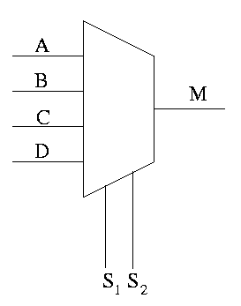
Look Up tables (LUTs)
A lookup table is an array that replaces runtime computation with a simpler array indexing operation
An n-input LUT is implemented using an n-input MUX and 2^{n} SRAM cells

Slide 28
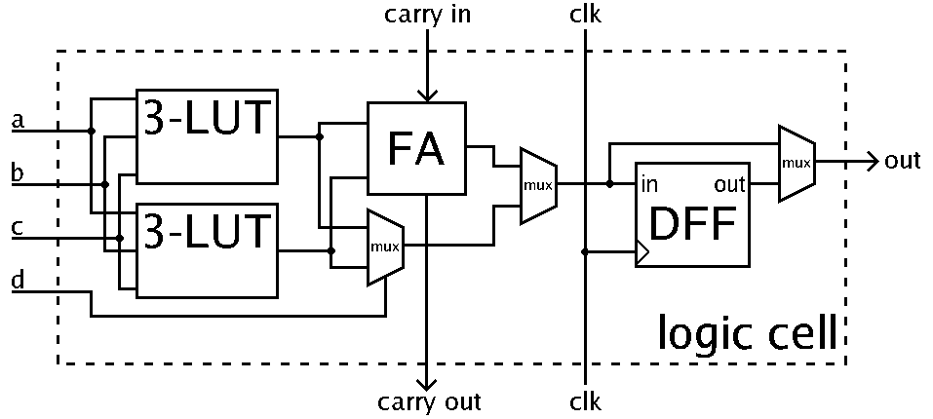
Configurable Logic Blocks (CLBs)
Logic blocks are the fundamental building blocks of modern FPGAs
A CLB consists of a few logic cells
A typical cell consists of a 4-input LUT, a Full adder (FA) and a D-type flip-flop

Slide 29
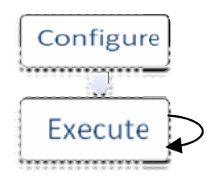
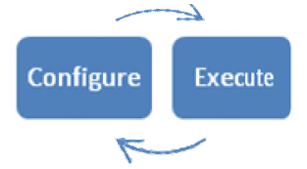
5. Reconfiguration Models
Static Reconfiguration – The reconfiguration is done at the time of compilation and loading of the program E.g. FPGAs
Dynamic Reconfiguration – The reconfiguration is done during runtime E.g. Advanced Chameleon Circuits
Partial Reconfiguration – Some part of the RF can be dynamically reconfigured while keeping the critical portions intact E.g. Modern FPGAs

Slide 30
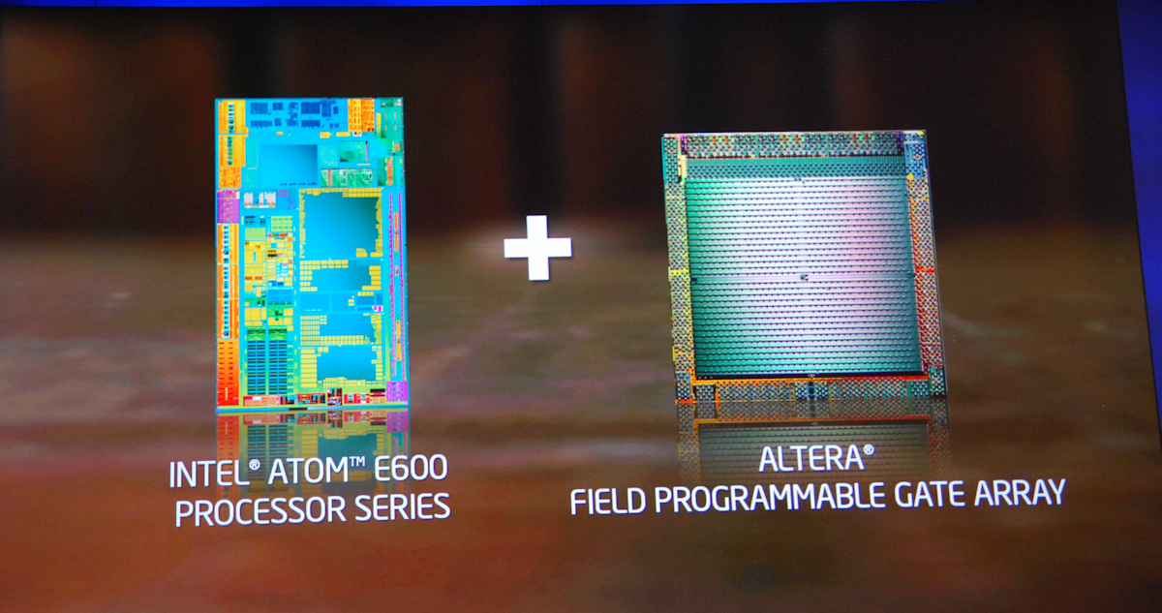
Advantages and Limitations

Slide 31
Advantages of RPs
ASIC like performance
High efficiency
Hardware reuse and greater functionality
Reduces power consumption
Reduced manufacturing and development costs
Adaptable to new requirements and standards

Slide 32
Limitations of RPs
Since most RPs are required to load the design configurations at start-up, security concern arises
Steep learning curve w.r.t software development
Circuit size that can be implemented with the present day RF is limited and only high end FPGAs support very large circuits
Timing issues can arise esp. during dynamic reconfigurations
Development Tools are still under developmental stages

Slide 33
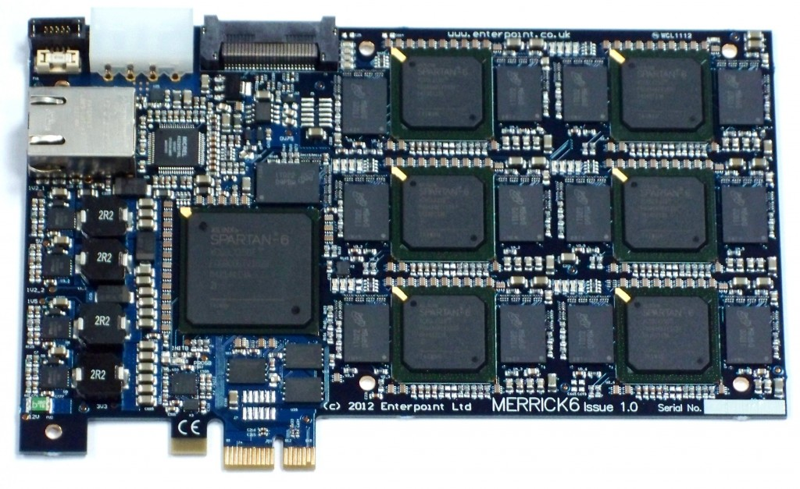
Applications

Slide 34
Application
Very fast and high encryption and decryption throughput
An e.g.: In elliptical curve cryptography with a key size of 270 bits an optimised dual-xeon computer at 2.6 GHz takes 196.71ms
The same operation is carried out on a Xilinx XC2V6000 FPGA running at 66MHz is completed in 0.36ms
This means the RP computes 540 times faster than the GPP while running at a 40 times slower clock speed

Slide 35
Application (contd …)
Very fast audio and video processing, encoding and decoding – Modern 4K and 3D TVs are using RPs to achieve very high resolution video processing and 3D rendering
Networking – RPs can facilitate very high packet processing capabilities and are used in routers, bridges and switches

Slide 36
Application (contd …)
Numeric and scientific computing – RPs can be used for DNA analysis and protein synthesis
Pattern matching – RPs can be used for pattern recognition that can be useful for market analysis

Slide 37
Conclusion
By using RPs, the total efficiency and speed of systems can be increased drastically
In future more of RPs will be replacing GPPs in various areas of applications
The pivoting step for development of RPs will be the advancement in development tools required for programming the RPs

Slide 38
References
[1] Damir Kirasic and Danko Basch, “Reconfigurable Processor Architectures: Varieties and Representations”, IET Journals & Magazines, Volume 10, Issue 1, Pages 102 – 108, 2012
[2] M. Aqeel Iqbal and Uzma Saeed Awan, “Reconfigurable Processor Architecture For High Speed Applications”, IEEE Journals & Magazines, Volume 10, Issue 4, Pages 96 - 101, 2009
[3] Lars Bauer, Muhammad Shafique, and Jörg Henkel, “Concepts, Architectures, and Run-time Systems for Efficient and Adaptive Reconfigurable Processors”, IEEE Conference Publications, Pages 213 – 221, June 2011

Slide 39
THANKYOU

Slide 40

ANY QUESTIONS…??

